Slide 1
Goal of this presentation
Introduce my research
Answer questions about my work
Give context for future presentations

Slide 2
Smoothed Point Cloud Dimensionality Reduction in a Plant Science Application for GWAS
By Elvis Kimara

Slide 3
Problem Definition
Problem: Given 1,400 plant point clouds (corn) how can we have a lower dimensional vectors or scalars that are an accurate estimate of the original point cloud
Why we care: each plant point cloud has about 30,000 points. We want to bring this down to a vector or scalar. And have this vector applied to other fields/research topics like GWAS
Research question: can we train a model to learn an accurate latent representation of 1,400 point clouds, use Lipschitz regularization to smoothen our results, and have the returned vector as a function that’s plottable and useful for GWAS

Slide 4
Terminologies
GWAS: (Genome-Wide Association Studies)
GWAS identifies genetic variations linked to specific traits.
The process involves scanning genomes across a population.
It is crucial for understanding genetic factors in disease and plant traits.
Relevance: Enables enhanced genetic marker identification in plant sciences, which is integral to your point cloud dimensionality reduction research.

Slide 5
Terminologies
Lipschitz Regularization
Defines stability in functions—small input changes cause small output changes.
Applied to ML for stable and robust neural network training.
Prevents overfitting and promotes generalization to new data.
Relevance: Your MLP model uses this to ensure smooth latent representations for reliable GWAS analysis.

Slide 6

Papers Focused On
DeepSDF learning Continuos SDF for shape representation
Learning Smooth Neural Functions via Lipschitz Regularization
Efficient and Accurate Estimate of Lipschitz
PointNet; Deep Learning on Point Sets for 3D classification and Segmentation
Implicit Geometric Regularization for Learning Shapes

Slide 7

Methodology (High level Overview)
Train a MLP to learn latent representations of the point clouds
1
Use SDF and Eikonal loss to learn the Implicit geometric representations
Enforce the Lipchitz regularizing term in the MLP
2
This is to ensure smoothed network for robustness and better convergence
Return vector after learning all latent representations
3
Experiment with different latent vector sizes
Make the Vector a function
4
So that it is plottable
And can be used for GWAS and other use cases

Slide 8

Advantages
Learning Latent Representations: Training a Multilayer Perceptron (MLP) to learn latent representations can be very effective in capturing the underlying structure of the data, leading to a more meaningful analysis in applications such as GWAS.
Use of SDF and Eikonal Loss: Utilizing Signed Distance Functions (SDF) alongside Eikonal loss helps in learning a smooth and continuous implicit function, which is beneficial for capturing the geometric information of point clouds.
Lipschitz Regularization: Enforcing the Lipschitz regularizing term in the MLP can lead to a more stable training process, promoting robustness and potentially leading to better convergence properties.
Smoothness and Robustness: The emphasis on smoothness can lead to robust latent representations that are less sensitive to noise or small perturbations in the data, which is especially important in biological data prone to variability.
Experimentation with Latent Vector Sizes: By experimenting with different sizes of latent vectors, the model can be tuned to find the optimal balance between complexity and expressiveness, potentially improving both the performance and the interpretability of the model.
Vector Functionality: Making the vector a plottable function increases the utility of the representations, allowing for visualization and further use in different applications beyond GWAS, such as phenotype prediction or evolutionary studies.

Slide 9

Drawbacks
Complexity of Training: Training MLPs, especially with complex loss functions like SDF and Eikonal, can be computationally intensive and require careful tuning of hyperparameters.
Overfitting Risk: With a complex model such as an MLP, there's a risk of overfitting to the training data, especially if the dataset is not sufficiently large or diverse.
Generalization Issues: While enforcing smoothness through Lipschitz regularization helps with robustness, there could be a trade-off where the model may not capture all the intricate details of the data, potentially leading to issues with generalization.
Dependency on Data Quality: The effectiveness of the latent representations learned by the MLP can be highly dependent on the quality and the preprocessing of the input point clouds.
Interpretability Challenges: Despite the potential for improved performance, the latent representations learned by MLPs can sometimes be difficult to interpret, which may be a limitation for certain GWAS applications where understanding the biological relevance of features is critical.
Optimization Difficulty: Balancing the SDF, Eikonal loss, and the Lipschitz constraint can be challenging, as the optimization landscape may become more complex, potentially leading to difficulties in training convergence

Slide 10

Baseline
Use a vanilla PointNET Autoencoder to learn accurate latent vector representations of the point clouds
01
Test accuracy on reconstruction
Experiment with different latent vector sizes
02
To test the best/most viable size
Use a simple architecture
03
Vanilla
No lipshitz smoothing
TBD: Have vector a plottable function
04
So it can be used in GWAS

Slide 11
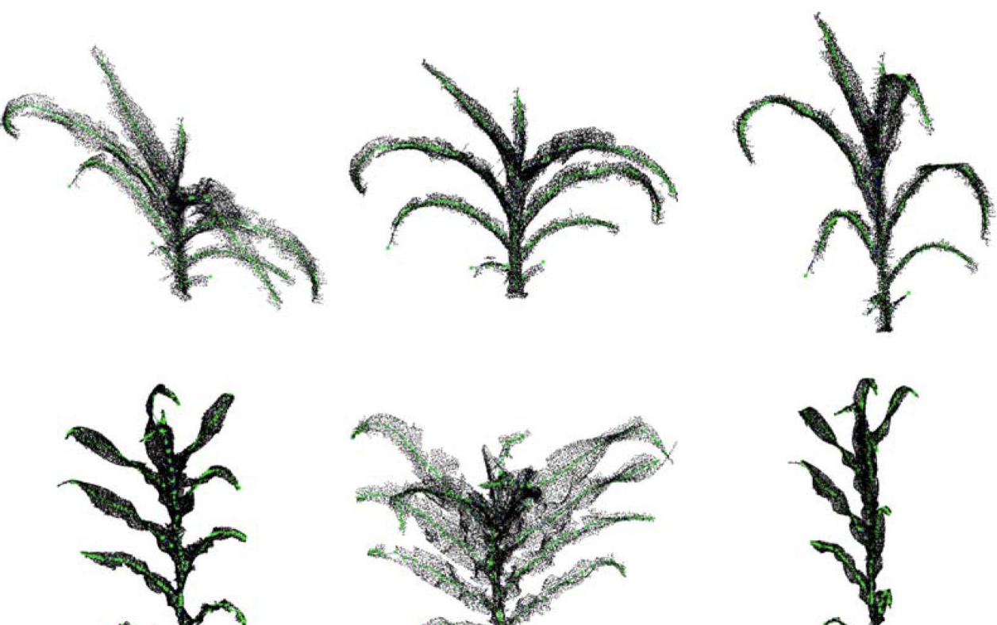
Input Data
The 1,400 plant point clouds during training.

Slide 12
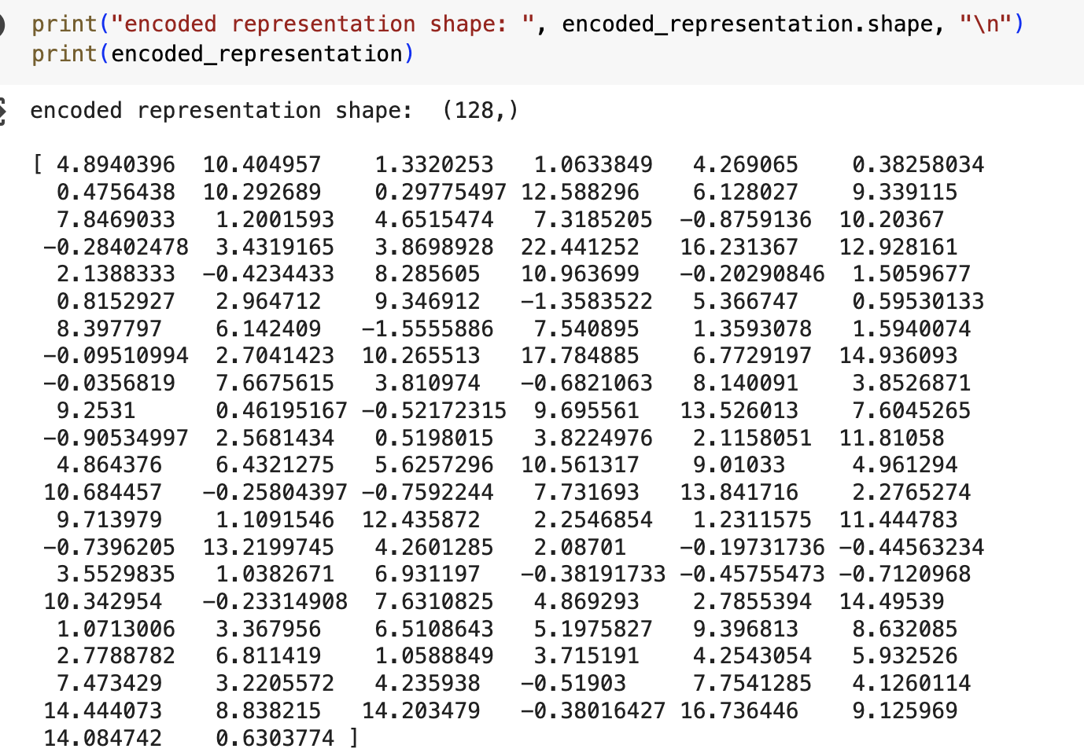
Output Data
The latent vector representation

Slide 13
Resources
DeepSDF learning Continuos SDF for shape representation
https://arxiv.org/abs/1901.05103
Learning Smooth Neural Functions via Lipschitz Regularization
https://arxiv.org/abs/2202.08345
Efficient and Accurate Estimate of Lipschitz
https://arxiv.org/abs/1906.04893
PointNet; Deep Learning on Point Sets for 3D classification and Segmentation
https://arxiv.org/abs/1612.00593
Implicit Geometric Regularization for Learning Shapes
https://proceedings.mlr.press/v119/gropp20a/gropp20a.pdf

Slide 14

Questions

